Slide 1
Designing a Battery Management System From a Real-Time System Perspective
Jinkyu Lee
Dept. of Computer Science and Engineering,
Sungkyunkwan University (SKKU)
2022.9.21-22 Samsung SDI

Slide 2
Instructor Information
Jinkyu Lee 이진규
Associate Professor
Department of Computer Science and Engineering 소프트웨어학과, SKKU (2014.3~)
Postdoctoral Researcher
Department of EECS, University of Michigan
Advisor: Prof. Kang G. Shin
B.S., M.S., Ph.D.
Department of Computer Science 전산학부, KAIST
Advisor: Prof. Insik Shin & Ikjun Yeom
Contact information
Email. jinkyu.lee@skku.edu
Website. https://rtclskku.github.io/website/jinkyulee.html
Real-Time Computing Lab@SKKU. https://rtclskku.github.io/website

Slide 3
Instructor Information
Research areas
Real-time system
ML (Machine learning) for RT, RT for ML
Software-defined battery management
Battery management systems
Mobile system
Real-time system
Specialty:
Real-time scheduling
- System design and analysis
with timing guarantees
- QoS support
- Resource management
Software-defined battery
management
Mobile
system

Slide 4
Instructor Information
Achievements: research
IEEE RTSS (Real-Time Systems Symposium)
Top 1 RT conference, about 30 papers published per year
19 papers published
IEEE RTAS (Real-Time and Embedded Technology and Application Symposium)
Top 2 RT conference, about 30 papers published per year
6 papers published
SCI(E) Journals
52 papers, including 17 IEEE/ACM transactions/journals
Achievements: professional activities
TPC (Technical Program Committee): IEEE RTSS 2018, 2020, 2021 and 2022
TPC: IEEE RTAS 2020, 2022 and 2023
TPC co-chair: IEEE RTCSA 2020

Slide 5
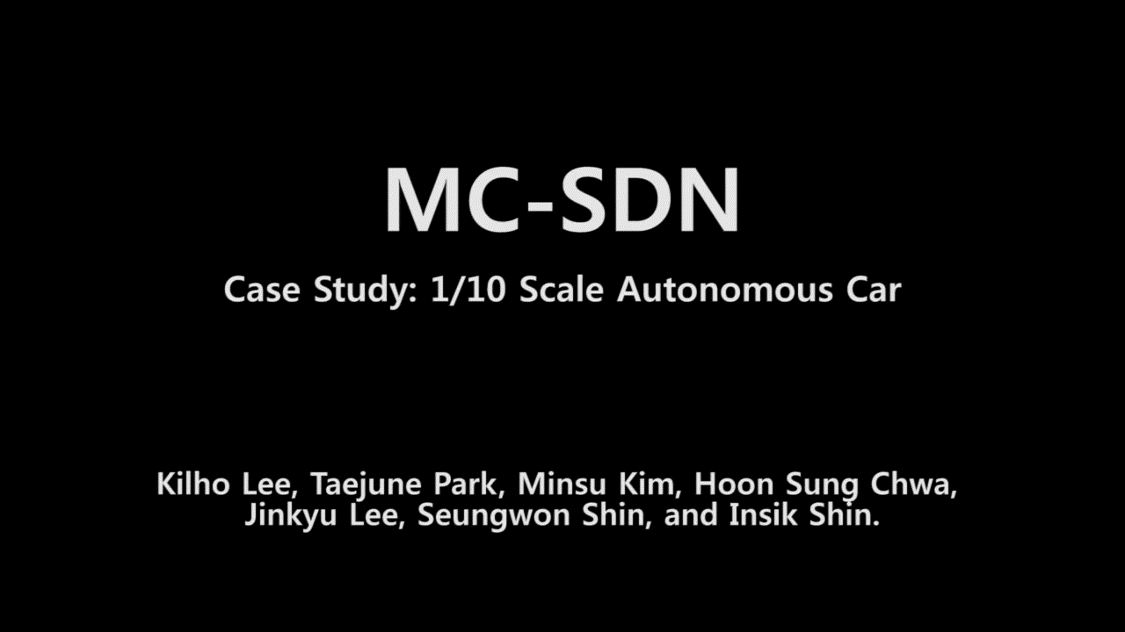
Instructor Information
Research example
How to provide timing guarantees for software-defined networks?
MC-SDN: Supporting Mixed-Criticality Real-Time Communication Using Software-Defined Networking IEEE RTSS 2018

Slide 6
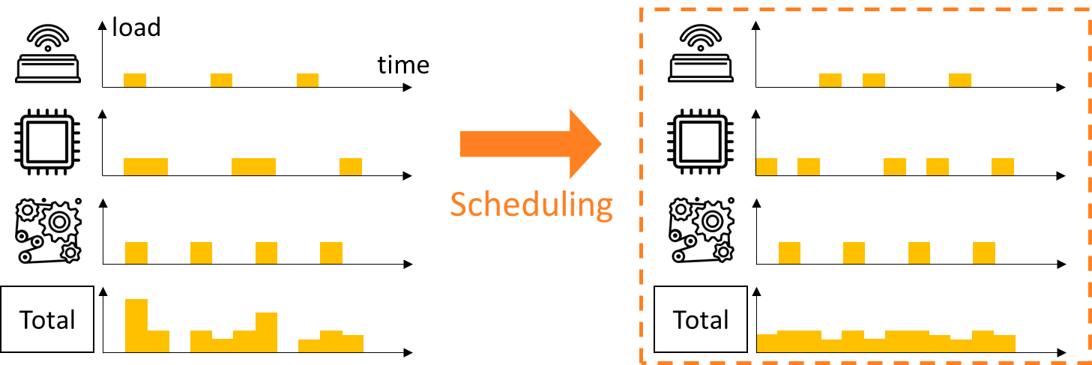
Instructor Information
Research example
How to minimize battery aging while providing timing guarantees of real-time tasks?
Battery Aging Deceleration for Power-Consuming Real-Time Systems
IEEE RTSS 2019

Slide 7
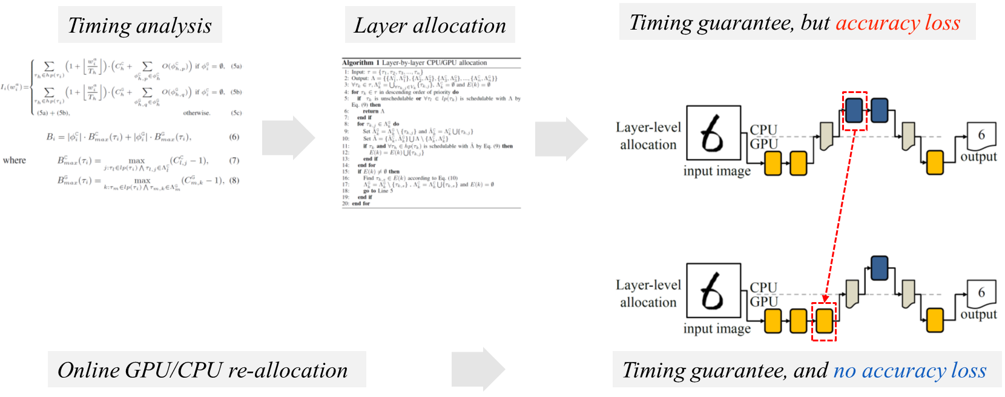
Instructor Information
Research example
How to fully utilize CPU and GPU for time-predictable execution for DNN tasks?
LaLaRAND: Flexible Layer-by-Layer CPU/GPU Scheduling for Real-Time DNN Tasks
IEEE RTSS 2021

Slide 8
Overall Schedule
1차시 (신동화 교수님)
9/19(월) 13~16시
실시간 시스템의 개념
2차시
9/21(수) 9~12시
실시간 태스크 스케줄링 기법
3차시
9/22(목) 13~16시
실시간 태스크 스케줄링 가능성 (Schedulability) 분석 기법
추후
배터리 관리 시스템의 태스크 구성과 스펙에 따른 실시간 시스템 성능 요구 분석 (현재 BMS 스펙 등을 검토 및 토의)
Designing a Battery Management System From a Real-Time System Perspective

Slide 9
Schedule for each day
(9/21)
09:00 – 10:15
Lecture
10:15 – 10:30
Break
10:30 – 11:45
Lecture
11:45 –
Q&A
(9/22)
13:00 – 14:15
Lecture
14:15 – 14:30
Break
14:30 – 15:45
Lecture
15:45 –
Q&A

Slide 10
RT SYSTEMS & RT SCHEDULING

Slide 11
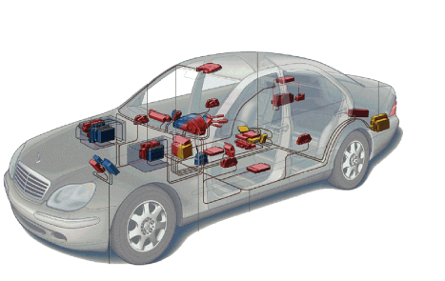
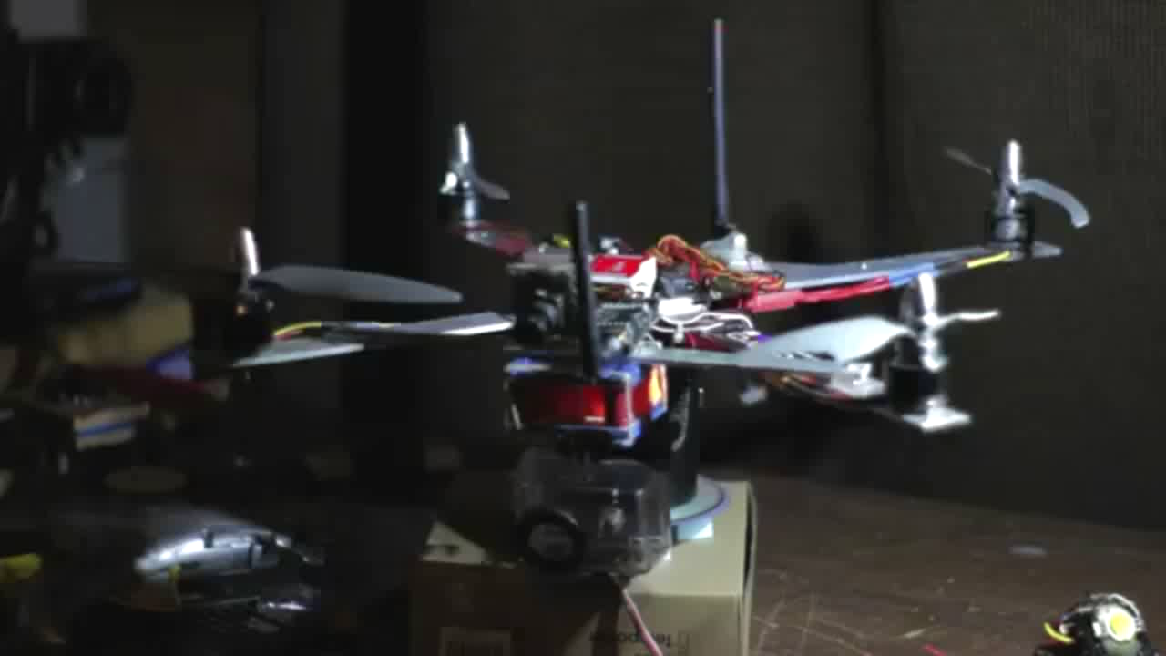

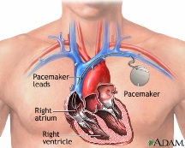
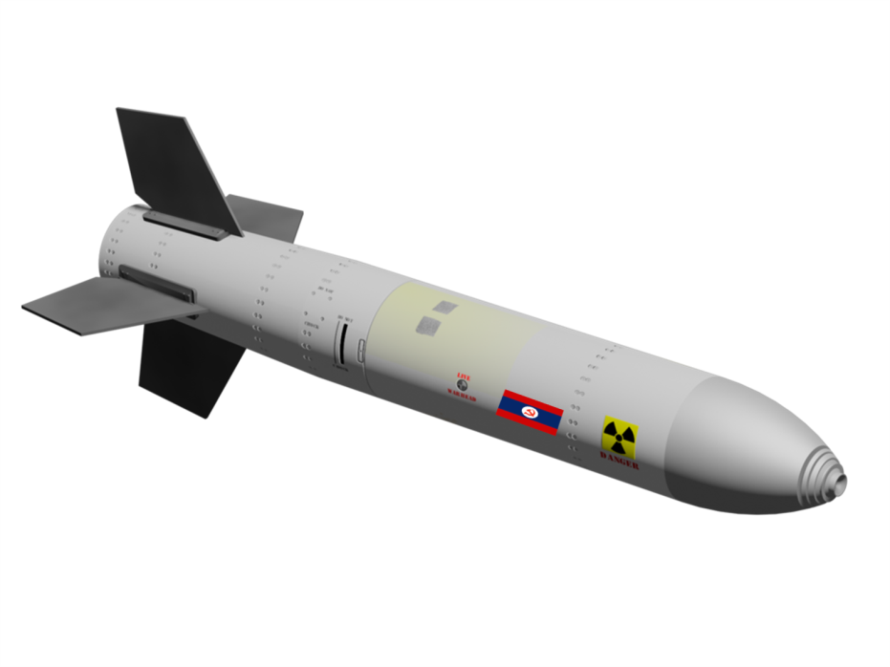



Real-Time System
Systems that operate with time constraints (deadlines)
Important to produce accurate results before deadlines
Usually for safety-critical systems or mission-critical systems
Automotive
Avionics
Medical Devices
Robots
Military
Smartphones
Multimedia
Factory Automation

Slide 12
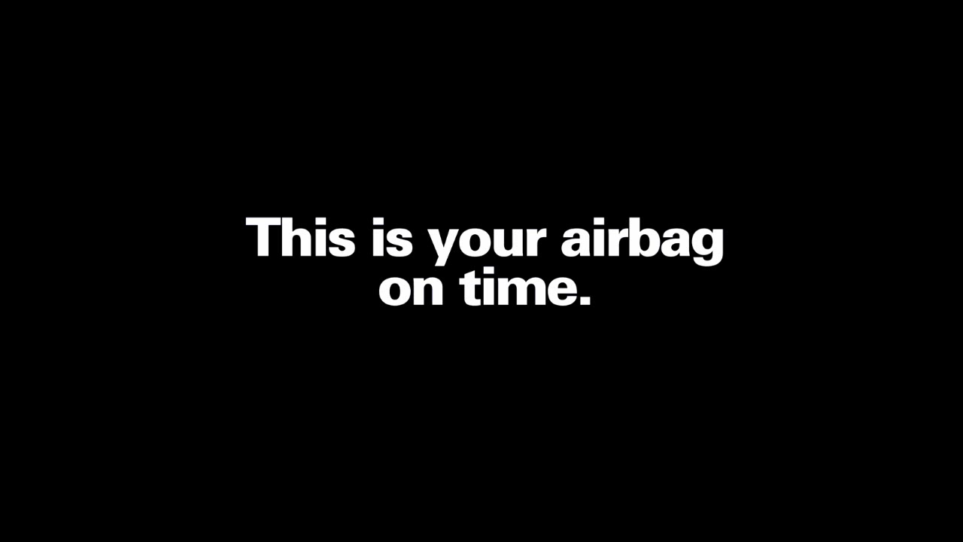
Real-Time System
Systems that operate with time constraints (deadlines)
Important to produce accurate results before deadlines
Usually for safety-critical systems or mission-critical systems
From Honda

Slide 13



Real-Time System
Systems that operate with time constraints (deadlines)
Important to produce accurate results before deadlines
Usually for safety-critical systems or mission-critical systems

Slide 14







Real-Time Systems: Research Topics
Timing guarantee and analysis
of computing systems
Design time-predictable
computing systems
+
Applications
Languages
Operating Systems
Middleware
Architecture
Hardware
…
Cyber Physical Systems: Design Challenges, IEEE ISORC, 2008.
MC-SDN: Supporting Mixed-Criticality Real-Time Communication
Using Software-Defined Networking, IEEE IoT Journal, 2019.

Slide 15
Real-Time Scheduling
Schedule all real-time tasks
such that there is no single job deadline miss
Platform
Constraints
Task model
Some contents are from “Real-Time Systems: Achievements and Perspectives” by Giorgio Buttazzo.

Slide 16
Real-Time Scheduling
Task models
Single job
Aperiodic
Sporadic
Periodic
DAG-structured
Gang-structured
…
Constraints
Precedence
Shared resources
Self-suspensions
Mode changes
Fully preemptive
Fully non-preemptive
Limited preemptive
…
Platforms
Uniprocessor
…
Multiprocessor
…
GPU + CPU
Distributed
…

Slide 17
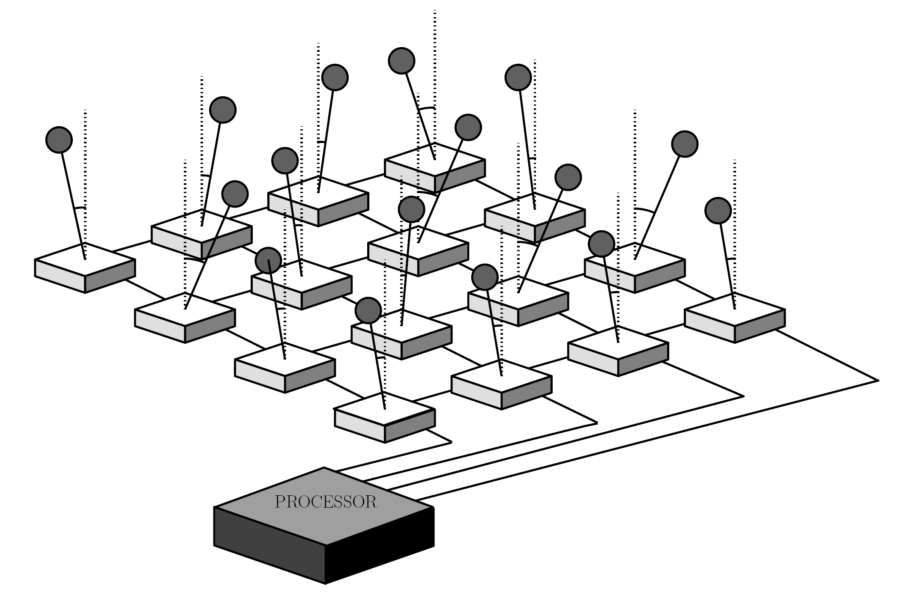
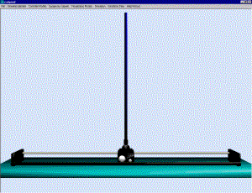
Real-Time Scheduling
reference input
A/D
control law
computation
D/A
sensor
actuator
Source: http://aar.faculty.asu.edu/research/mosart/mosart.html
Job 1
Job 2
Job 3
C₁=2
τ₁
= Task 1
D₁=4
D₁
D₁
T₁=5
T₁
T₁

Slide 18
Real-Time Scheduling
Uniprocessor
T₁=4, D₁=4, C₁=1
τ₁
(4,1)
τ₂
(5,2)
5
10
15
τ₃
(7,2)
5
10
15

Slide 19
Real-Time Scheduling
: at each time slot, only one job can be executed.
Uniprocessor
T₁=4, D₁=4, C₁=1
τ₁
(4,1)
τ₂
(5,2)
5
10
15
τ₃
(7,2)
5
10
15
Schedule all real-time tasks
such that there is no single job deadline miss
= Schedulable

Slide 20
Real-Time Scheduling
Uniprocessor: at each time slot, only one job can be executed.
T₁=4, D₁=4, C₁=1
τ₁
(4,1)
τ₂
(5,2)
5
10
15
τ₃
(7,2)
5
10
15
τ₁ > τ₂ > τ₃, non-preemptive
τ₁ > τ₂ > τ₃, preemptive
Deadline miss

Slide 21
Real-Time Scheduling
Task models
Single job
Aperiodic
Sporadic
Periodic
DAG-structured
Gang-structured
…
Constraints
Precedence
Shared resources
Self-suspensions
Mode changes
Fully preemptive
Fully non-preemptive
Limited preemptive
…
Platforms
Uniprocessor
…
Multiprocessor
…
GPU + CPU
Distributed
…

Slide 22
Real-Time Scheduling
Optimization criteria
Feasibility
Response time
Maximum lateness
Utilization bandwidth
Energy consumption
Temperature
Number of processors
Schedule all real-time tasks
such that there is no single job deadline miss

Slide 23
Real-Time Scheduling
Industrial/practical usage of real-time scheduling
Rate Monotonic is used in most industrial settings.
Priority Inheritance is in most RT kernels.
Sporadic Server is specified in POSIX.
CBS is implemented in LINUX.
EDF is now supported by a few kernels
Erika Enterprise: certified OSEK and adopted by Magneti Marelli in next generation ECUs
Ada 2005 runtime support
Linux: SCHED_DEADLINE in mainline since June 2014
A lot of RT Tools are now available for
WCET estimation, schedulability analysis, scheduling simulation, formal verification, etc.

Slide 24
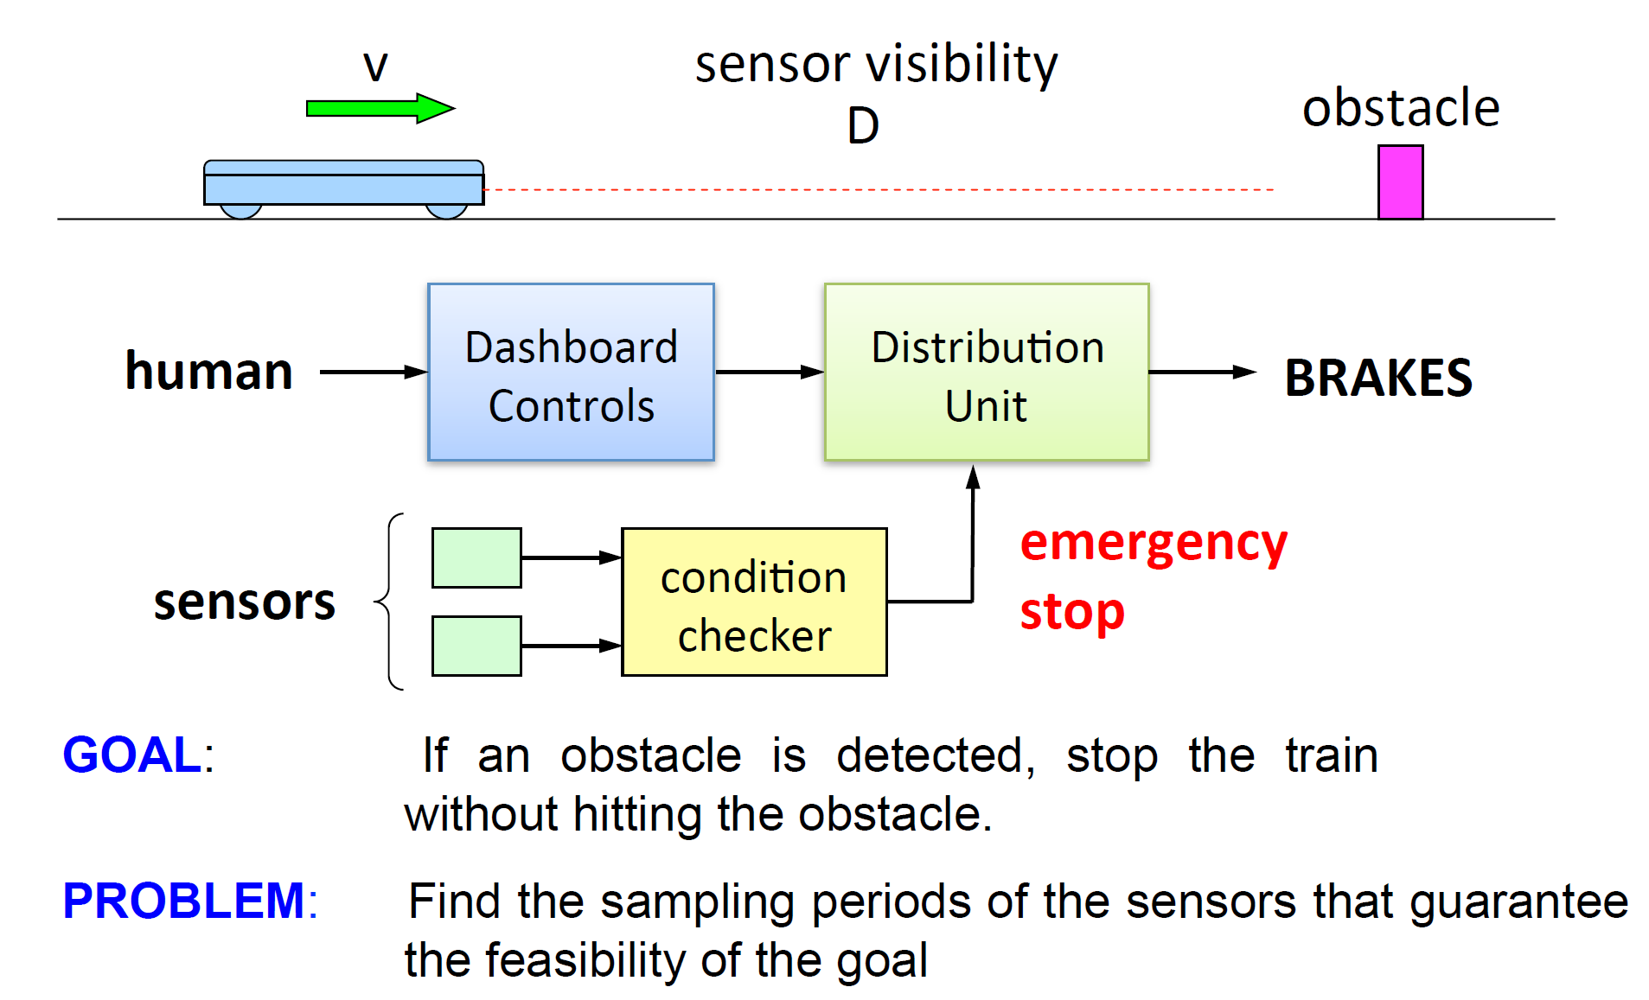
Real-Time Scheduling
A practical example of real-time scheduling
From “Real-Time Systems: Achievements and Perspectives” by Giorgio Buttazzo

Slide 25
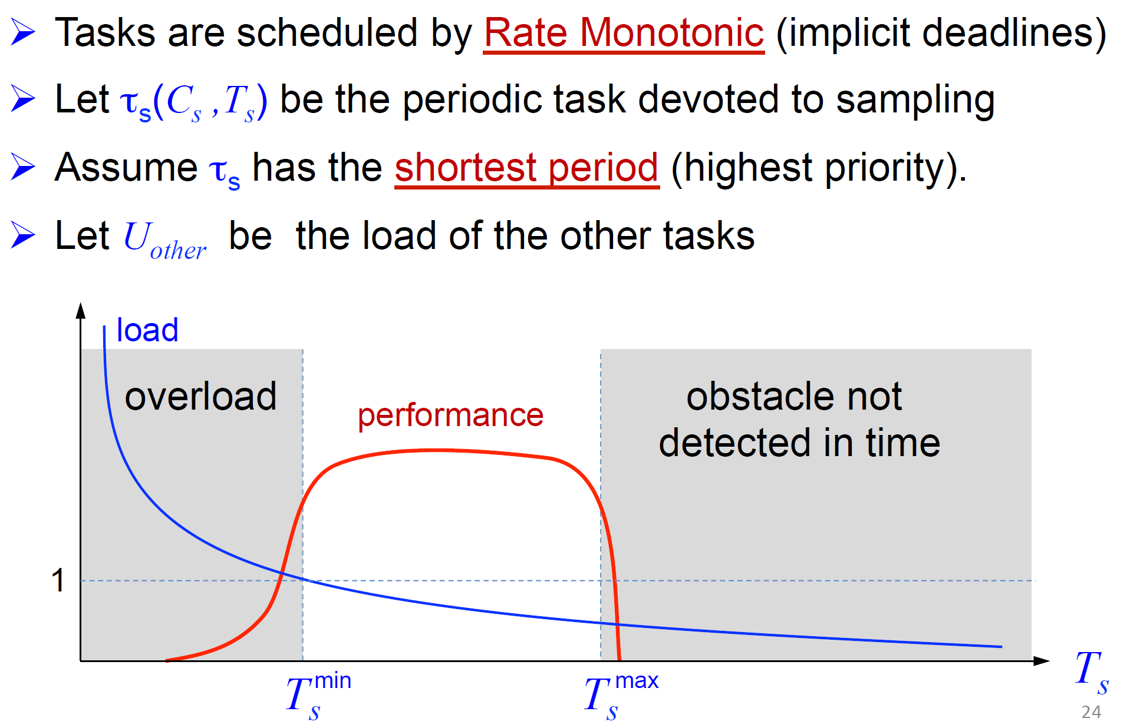
Real-Time Scheduling
A practical example of real-time scheduling
From “Real-Time Systems: Achievements and Perspectives” by Giorgio Buttazzo

Slide 26
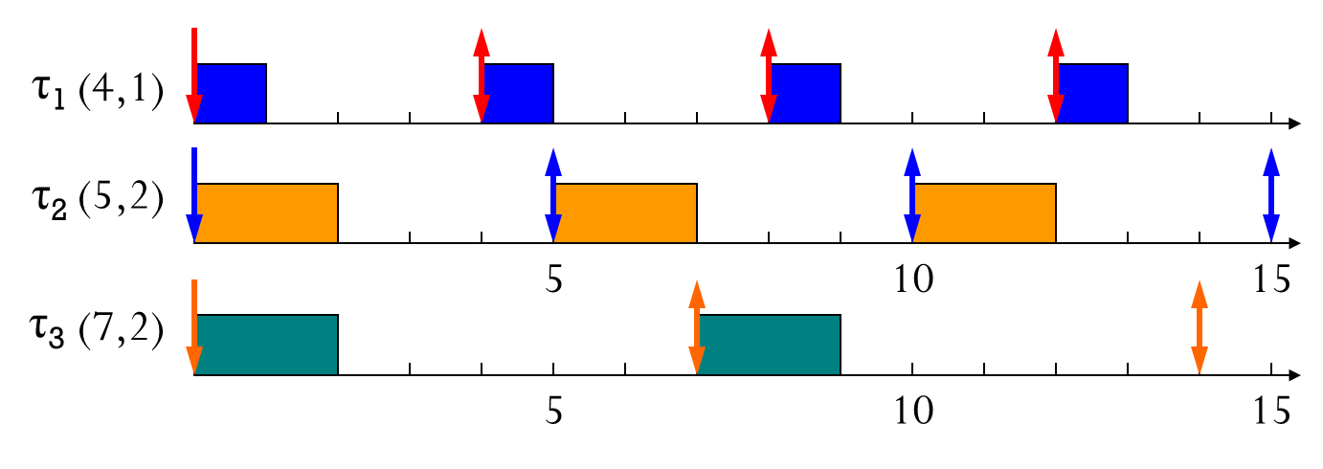
Real-Time Scheduling
A practical example of real-time scheduling
What is the physical meaning of 1/4 + 2/5 + 2/7?
Utilization
What if the utilization is larger than 1.0?
From “Real-Time Systems: Achievements and Perspectives” by Giorgio Buttazzo

Slide 27
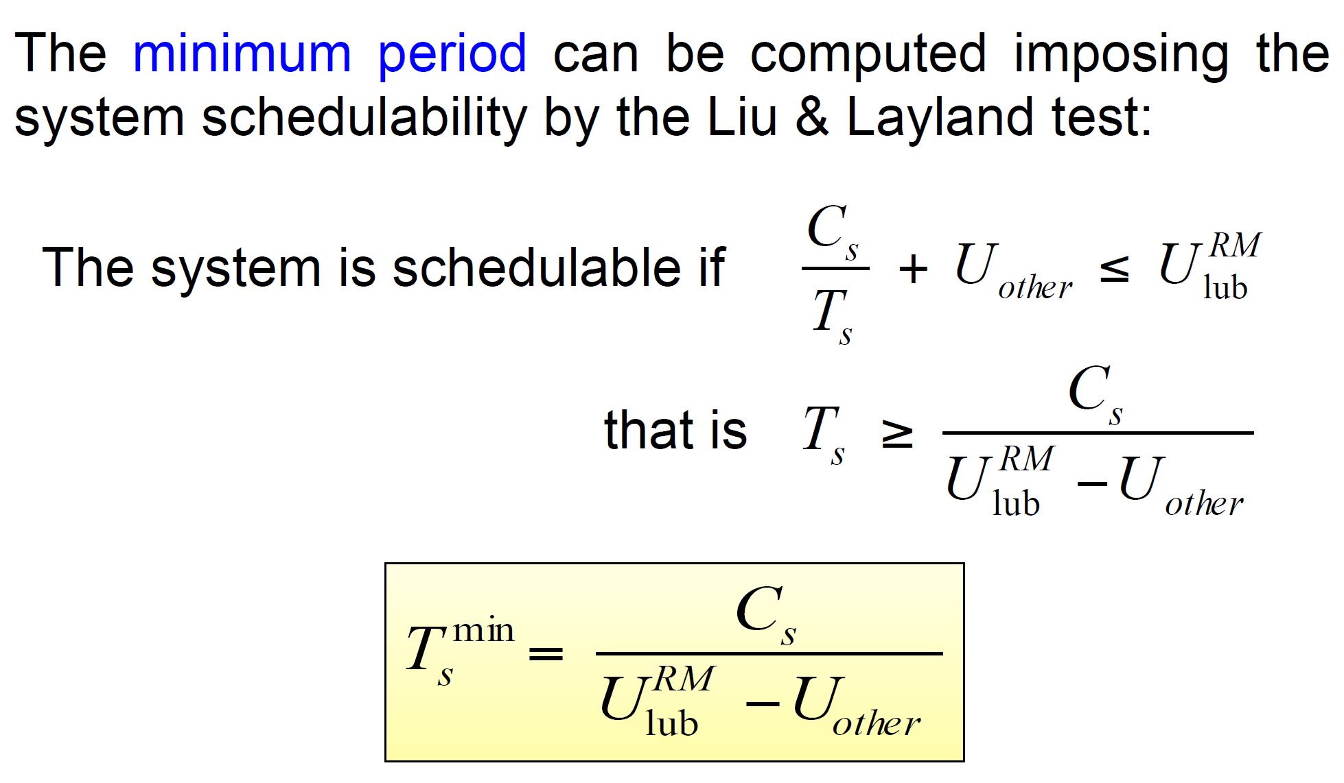
Real-Time Scheduling
A practical example of real-time scheduling
Example: 1/4 + 2/5 + 2/7 <= 0.7
From “Real-Time Systems: Achievements and Perspectives” by Giorgio Buttazzo

Slide 28
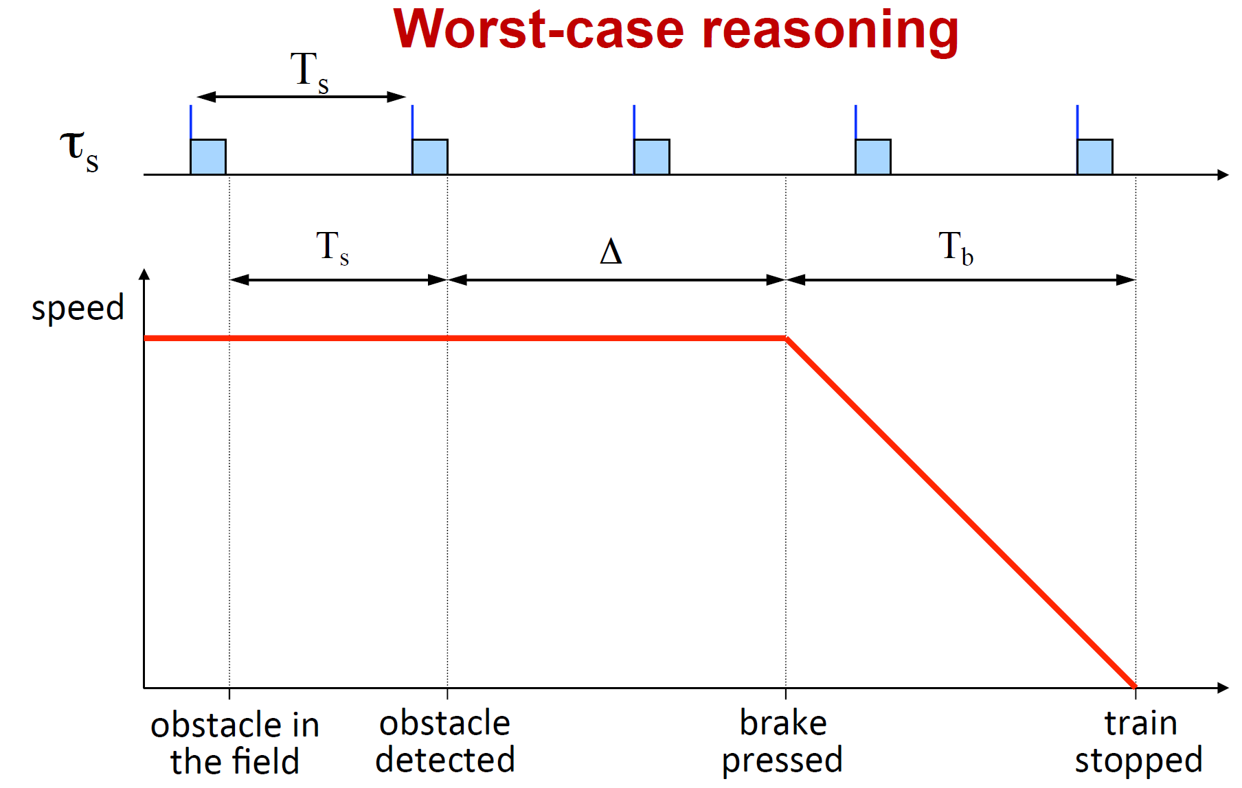
Real-Time Scheduling
A practical example of real-time scheduling
From “Real-Time Systems: Achievements and Perspectives” by Giorgio Buttazzo

Slide 29
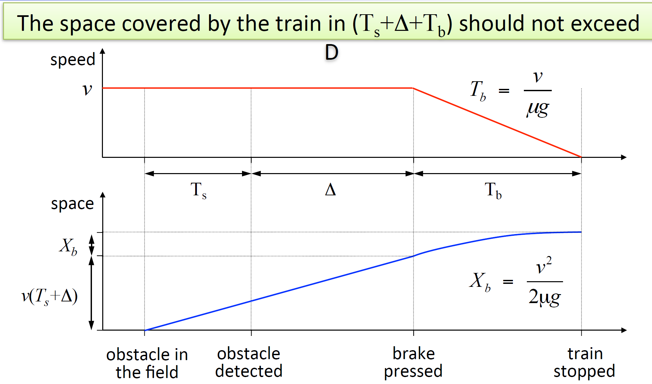
Real-Time Scheduling
A practical example of real-time scheduling
From “Real-Time Systems: Achievements and Perspectives” by Giorgio Buttazzo

Slide 30
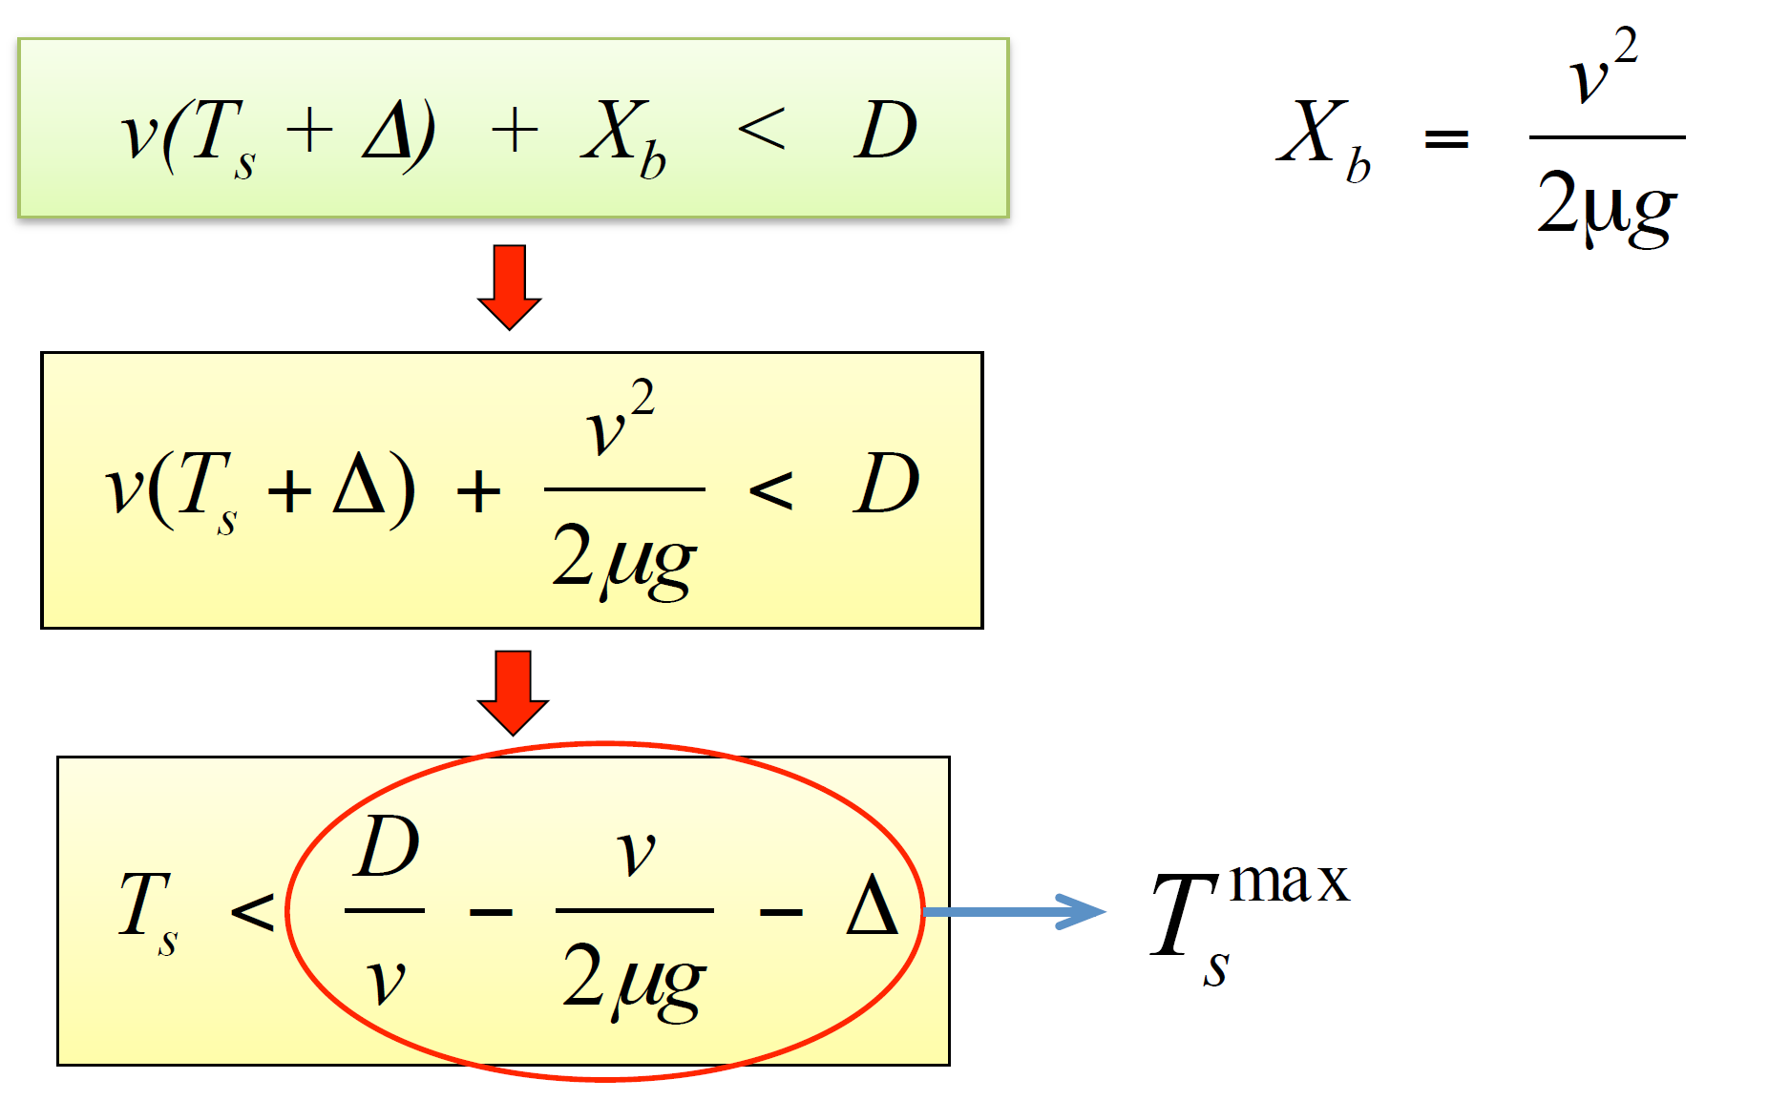
Real-Time Scheduling
A practical example of real-time scheduling
From “Real-Time Systems: Achievements and Perspectives” by Giorgio Buttazzo

Slide 31
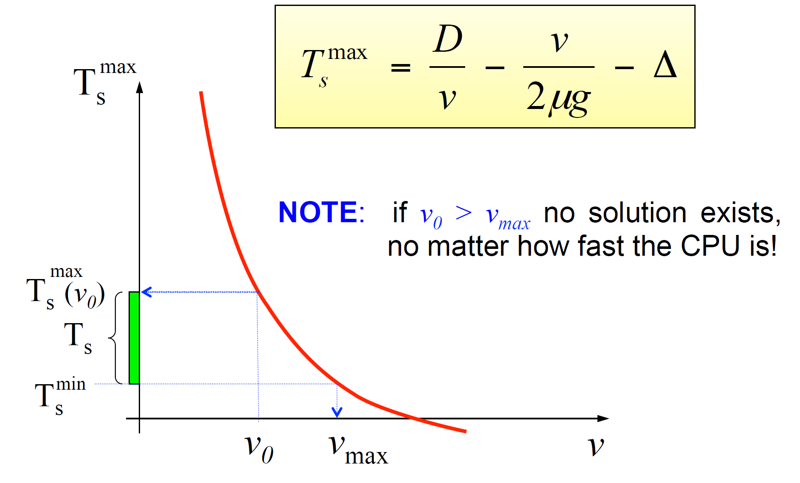
Real-Time Scheduling
A practical example of real-time scheduling
From “Real-Time Systems: Achievements and Perspectives” by Giorgio Buttazzo

Slide 32
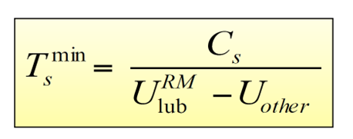
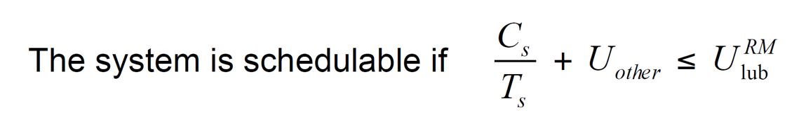
Real-Time Scheduling
A practical example of real-time scheduling
Why this is possible?
Scheduling algorithm + Schedulability analysis
From “Real-Time Systems: Achievements and Perspectives” by Giorgio Buttazzo

Slide 33
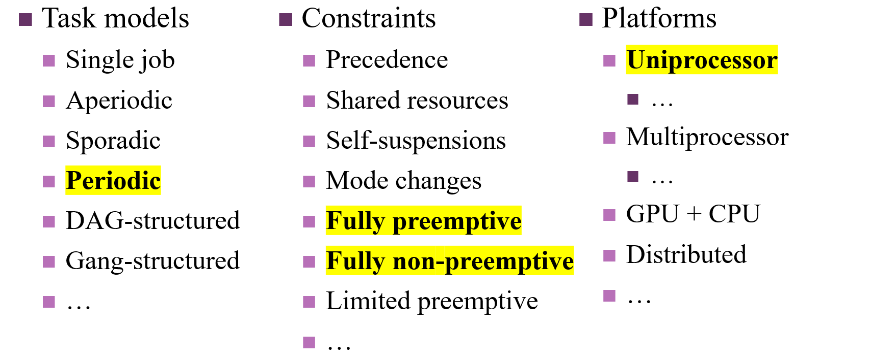
Real-Time Scheduling
Task model, constraints and platform are usually given.
Then, how can we achieve timeliness of a real-time systems?
Schedule all real-time tasks
such that there is no single job deadline miss

Slide 34
Real-Time Scheduling
From now on, we focus on the following periodic/sporadic task model
τ_{i} :Task i
T_{i}: the minimum separation / period
C_{i}: the worst-case execution time (WCET)
D_{i}: the relative deadline
Job: an instance of a task
(T_{i}, C_{i} , D_{i})
Or
(T_{i}, C_{i}), implying T_{i} = D_{i}
Job 1
Job 2
Job 3
τ₁(T₁,C₁,D₁)
C₁=2
τ₁ (5,2,3)
D₁=4
D₁
D₁
T₁=5
T₁
T₁
τ₃(T₃,C₃)
Job 1
Job 2
τ₃
(7,2)

Slide 35
Real-Time Scheduling
From now on, we focus on the following periodic/sporadic task model
τ_{i} :Task i
T_{i}: the minimum separation / period
C_{i}: the worst-case execution time (WCET)
D_{i}: the relative deadline
Where do these parameters come from?
T_{i} and D_{i}: usually from the target system (recall the hitting-obstacle example)
C_{i}: empirically measured, or code analysis
WCET analysis, under given platform

Slide 36
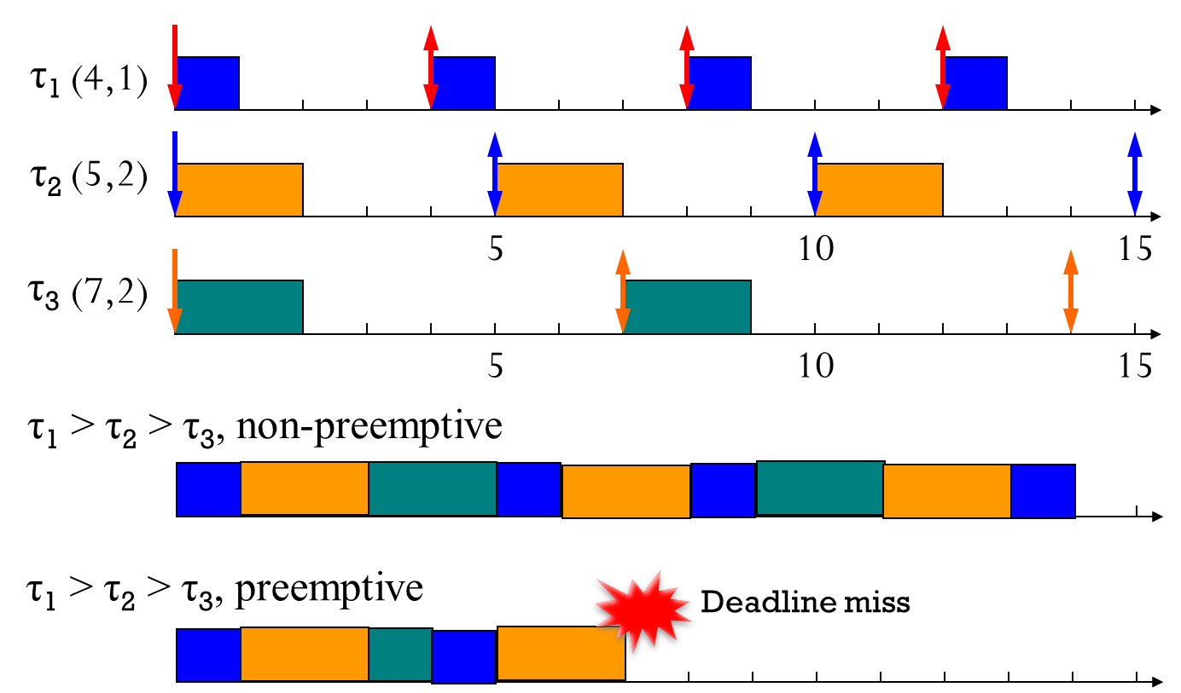
Real-Time Scheduling
From now on, we focus on the fully preemptive constraint and a uniprocessor platform.
A higher-priority job can preempt a currently-executing lower-priority job.
At each time slot, only one job can be executed.
Where do these constraints/platforms come from?
Usually from the target system and its design

Slide 37
Real-Time Scheduling
Scheduling goal
Under the periodic/sporadic task model, the fully preemptive constraint, and a uniprocessor platform
Two main components for real-time scheduling
Scheduling algorithm
Determine when each job executes (which job to be executed)
Schedulability analysis
Guarantee no deadline miss of a given task set under the target scheduling algorithm
Schedule all real-time tasks
such that there is no single job deadline miss
Exact (sufficient and necessary)
Only sufficient

Slide 38
Real-Time Scheduling
Two main components for real-time scheduling
Scheduling algorithm
Determine when each job executes (which job to be executed)
Schedulability analysis
Guarantee no deadline miss of a given task set under the target scheduling algorithm
Can we guarantee no deadline miss in the future?
Scheduling
Algorithm
Schedulability Analysis

Slide 39
Real-Time Scheduling
Why do we need schedulability analysis? Isn’t it possible to guarantee schedulability simply by simulating a target set of tasks?
Is it possible to simulate all different combinations of offsets?
Can each simulation guarantee the schedulability even with actual execution times less than their corresponding WCETs?
Is it feasible to simulate a target set of tasks if their LCM is very large?
Can we guarantee no deadline miss in the future?
Scheduling
Algorithm
Schedulability Analysis

Slide 40
Real-Time Scheduling
Which scheduling algorithm with which condition (i.e., schedulability analysis) guarantees that there is no single job deadline miss forever?
With any offset,
With any actual execution time,
With any arbitrary long period,
Example
Can we guarantee no deadline miss in the future?
Scheduling
Algorithm
Schedulability Analysis

Slide 41
UNIPROCESSOR SCHEDULING

Slide 42
Real-Time Scheduling
Let’s focus on the most popular (simplest) setting.
A single processor
Hard deadline
Independent periodic tasks
Relative deadline = period (D_{i} = T_{i})
Preemptable without any limit
No overhead for context switch

Slide 43
Real-Time Scheduling
How can this setting be extended?
VxWorks, Xen, RT Linux
Practice
Theory
Preemption cost
analysis
D_{i} ≤ T_{i}
Dependent task model, e.g., resource sharing
A single processor
Hard deadline
Independent periodic tasks
D_{i} = T_{i}
Preemptable without any limit and overhead for context switch
Non-preemptive scheduling
Hierarchical model (virtualization)
Soft deadline

Slide 44
Clock-Driven Task Scheduling
Clock-driven
a schedule determines (off-line) which job to be executed at each instant
static or cyclic
predictable and deterministic
scheduler: invoked by a timer
multiple tables for different operation modes
T₁= 6, C₁= 3, D₁= 6
T₂= 8, C₂= 3, D₂= 8 Major cycle = lcm (6,8) = 24

Slide 45
Pros and Cons of Cyclic Schedule
Pros
Simple, table-driven, easy to validate (knows what’s going on at any moment)
Fits well for harmonic periods and small system variations
Static schedule => deterministic, static resource allocation, no preemption
Small jitter
Cons
Difficult to change (need to re-schedule all tasks)
Fixed released times for the set of tasks
Difficult to deal with different temporal dependencies
Scheduling algorithm may become complex (NP-hard)
Doesn’t support aperiodic and sporadic tasks efficiently

Slide 46
Round-Robin Task Scheduling
Weighted Round-robin
Interleave job executions
Allocate a time slice to each job in the FIFO queue
Time slice may vary while sharing the processor
Good for pipelined jobs, e.g., network packets
T₁= 6, C₁= 3, D₁= 6
T₂= 8, C₂= 3, D₂= 8 Major cycle = lcm (6,8) = 24

Slide 47
Priority-Driven Task Scheduling
Priority-driven
The highest-priority job gets to run until completion or blocked
A processor is never idle if ready jobs are waiting (work-conserving)
Preemptive or non-preemptive
Priority assignment can be static or dynamic
Scheduler just looks at the priority queue for waiting jobs (list schedule)
T₁= 6, C₁= 3, D₁= 6
T₂= 8, C₂= 3, D₂= 8 Major cycle = lcm (6,8) = 24

Slide 48
Priority-Driven Task Scheduling
Why priority-driven scheduling algorithm?
Use priority to represent urgency/importance
Easy implementation of scheduler (compare task priorities and then dispatch tasks accordingly)
Tasks can be added or removed easily
No direct control of execution instant

Slide 49
Classification of Priority-Driven Scheduling
Task-level fixed-priority (TFP): all jobs of a periodic task have the same fixed priority
RM (Rate-monotonic) ^{[Liu and Layland 1973]} – the higher the task frequency, the higher its priority
Task-level dynamic-priority: different priorities to individual jobs of a periodic task
Job-level fixed-priority (JFP): priority of each job is fixed
EDF (Earliest Deadline First) ^{[Liu and Layland 1973]}
Job-level dynamic-priority (JDP): priority of each job can change over time
LLF (Least Laxity First) ^{[Leung 1989]}
Less Overhead
< Expressiveness> >
JDP
JFP
TFP
More
Expressive

Slide 50
Classification of Priority-Driven Scheduling
Task-level fixed-priority (TFP): all jobs of a periodic task have the same fixed priority
RM (Rate-monotonic) ^{[Liu and Layland 1973]} – the higher the task frequency, the higher its priority
τ₁
(3,1)
Task₁
T₁=3
C₁=1
τ₂
(5,3)
Task₂
T₂=5
C₂=3

Slide 51
Classification of Priority-Driven Scheduling
Job-level fixed-priority (JFP): priority of each job is fixed
EDF (Earliest Deadline First) ^{[Liu and Layland 1973]}
τ₁
(3,1)
Task₁
T₁=3
C₁=1
τ₂
(5,3)
Task₂
T₂=5
C₂=3

Slide 52
Classification of Priority-Driven Scheduling
Job-level dynamic-priority (JDP): priority of each job can change over time
LLF (Least Laxity First) ^{[Leung 1989]}
τ₁
(3,1)
2
1
2
2
1
Task₁
T₁=3
C₁=1
2
2
1
2
2
τ₂
(5,3)
Task₂
T₂=5
C₂=3

Slide 53
Classification of Priority-Driven Scheduling
Can we guarantee no deadline miss of all jobs of a given task set under each scheduling algorithm?
TFP: RM
JFP: EDF
JDP: LLF
What is the maximum utilization?
U = ∑ C_{i}/T_{i} ≤ 1.0
Example: 1/4 + 2/5 + 2/7
Can each scheduling algorithm achieve the maximum utilization?

Slide 54
RM: Overview
Critical instant under RM
Utilization-based analysis
U ≤ n(2^{1/n} – 1.0)
n → ∞, n(2^{1/n} – 1.0) → 0.69
Only sufficient
Response-time analysis
Exact
Some applications
Schedulability with transient overhead, interrupts and blocking
Without loss of generality
T₁ ≤ T₂ ≤… ≤ T_{n}

Slide 55
RM: Critical Instant
Critical instant of τ_{i}
A job of τ_{i} arriving at that instant has the largest response time
Which τ₂ has the maximum response time?
In-phase instant is critical under RM
All higher priority tasks are released at the same instant of J_{i,c} (assume all jobs are completed before the next job is released)
Task₁ Task₂
Task_{1,} Task₂
Task₂ Task₁
Why?

Slide 56
RM: Utilization-Based Analysis
Let’s consider two tasks
Task₂ can only be executed when Task₁ is not in the system.
Let T₂ < 2T₁. Determine the maximum schedulable C_{2.}
If T₂ ≤ T₁+C₁, max(C₂) = T₁ – C₁
U=C₁/T₁+ (T₁-C₁)/T₂
Else, max(C₂)=T₂-2C₁
U=C₁/T₁ + (T₂-2C₁)/T₂
Proof of U ≤ n(2^{1/n} – 1.0)
p₂
maximal e₂
p₂
e₁
e₁
e₁
0 p₁ 2p₁

Slide 57
RM: Utilization-Based Analysis
Given C₁, T₁, and T₂, plot U
The minimum U occurs when
T₂ = T₁+C₁
where U = C₁/T₁+(T₁-C₁)/(T₁+C₁)
What is the minimum U?
Take the derivative w.r.t T₁ and set dU/dT₁=0
We will get C₁=(2^{1/2}-1.0)T₁ and U=0.828
General cases with n
U
1
T₂=T₁ T₂=nT₁
-C₁*T₁⁻²-(T₁-C₁)*(T₁+C₁) ⁻² + (T₁+C₁)⁻¹=0
-C₁*T₁⁻²+2C₁*(T₁+C₁) ⁻²=0
RM-schedulable if U ≤ n(2^{1/n} – 1.0)

Slide 58
RM: Utilization-Based Analysis
Example
Total utilization is
.200 + .267 + .286 = .753 < U(3)=3(2^{1/3} – 1.0)=.779
The periodic tasks in the example are schedulable according to the UB test.
 | C_{i} | T_{i} | U_{i}
Task₁ | 20 | 100 | 0.200
Task₂ | 40 | 150 | 0.267
Task₃ | 100 | 350 | 0.286

Slide 59
RM: Utilization-Based Analysis
Example
Total utilization is
.400 + .267 + .286 = .953 > U(3)=3(2^{1/3} – 1.0) =.779
UB test cannot deem the task schedulable.
Try the exact analysis
 | C_{i} | T_{i} | U_{i}
Task₁ | 40 | 100 | 0.400
Task₂ | 40 | 150 | 0.267
Task₃ | 100 | 350 | 0.286

Slide 60
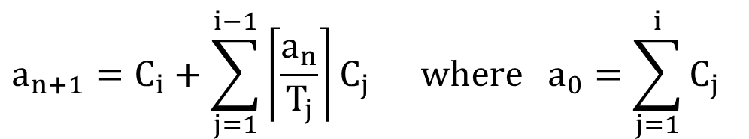
RM: Response-Time Analysis
Response time analysis
The duration between a job’s release time and finishing time
Test terminates when a_{n+1} = a_{n}
Task i is schedulable if its response time is before its deadline: a_{n} ≤ T_{i}
a_{n} is the response time of Task_{i}
Can be applied to any TFP
Not only RM, but also any TFP
Without loss of generality
T₁ ≤ T₂ ≤… ≤ T_{n}
$$a_{n+1}=C_{i}+\sum_{j=1}^{i−1}{\left\lceil \frac{a_{n}}{T_{j}}\right\rceil }C_{j} \text{where} {\text{a}}_{0}=\sum_{j=1}^{i}{C_{j}}$$
A set of higher-priority tasks

Slide 61
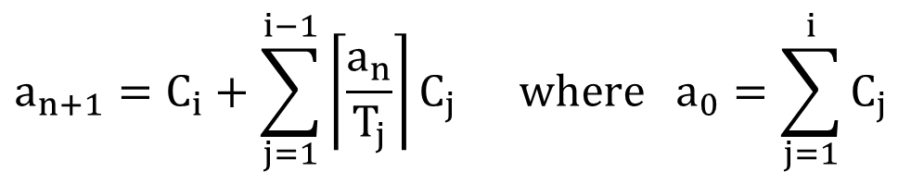
RM: Response-Time Analysis
Without loss of generality
T₁ ≤ T₂ ≤… ≤ T_{n}
$$a_{n+1}=C_{i}+\sum_{j=1}^{i−1}{\left\lceil \frac{a_{n}}{T_{j}}\right\rceil }C_{j} \text{where} {\text{a}}_{0}=\sum_{j=1}^{i}{C_{j}}$$
A set of higher-priority tasks

Slide 62
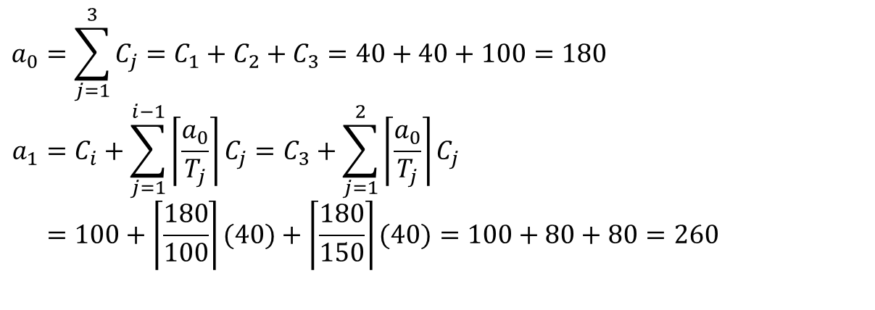
RM: Response-Time Analysis
How does this work? --- Task₃ is schedulable?
 | C_{i} | T_{i} | U_{i}
Task₁ | 40 | 100 | 0.400
Task₂ | 40 | 150 | 0.267
Task₃ | 100 | 350 | 0.286
$$a_{0}=\sum_{j=1}^{3}{C_{j}}=C_{1}+C_{2}+C_{3}=40+40+100=180 \\ a_{1}=C_{i}+\sum_{j=1}^{i−1}{\left\lceil \frac{a_{0}}{T_{j}}\right\rceil }C_{j}=C_{3}+\sum_{j=1}^{2}{\left\lceil \frac{a_{0}}{T_{j}}\right\rceil }C_{j} \\ =100+\left\lceil \frac{180}{100}\right\rceil (40)+\left\lceil \frac{180}{150}\right\rceil (40)=100+80+80=260$$

Slide 63
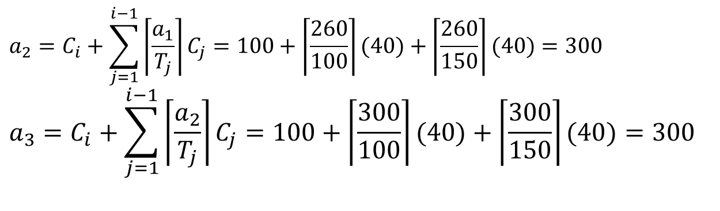
RM: Response-Time Analysis
$$a_{2}=C_{i}+\sum_{j=1}^{i−1}{\left\lceil \frac{a_{1}}{T_{j}}\right\rceil }C_{j}=100+\left\lceil \frac{260}{100}\right\rceil (40)+\left\lceil \frac{260}{150}\right\rceil (40)=300 \\ a_{3}=C_{i}+\sum_{j=1}^{i−1}{\left\lceil \frac{a_{2}}{T_{j}}\right\rceil }C_{j}=100+\left\lceil \frac{300}{100}\right\rceil (40)+\left\lceil \frac{300}{150}\right\rceil (40)=300$$
a₃ = a₂ = 300 Done!
Task is schedulable using RT test.
a₃ = 300 < T₃ = 350

Slide 64
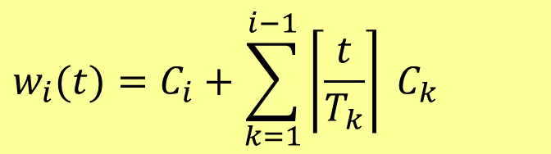
RM: Response-Time Analysis
Why does this work?
Time-demand analysis based on critical instant
If J_{i} is done at t, then the total work must be done in [0,t] is (from J_{i} and all higher priority tasks): time demand function
Can we find t ≤ D_{i} such that w_{i}(t) ≤ t
Cannot check all t [0, d_{i}]
Check all arrival instants and d_{i}
$$w_{i}(t)=C_{i}+\sum_{k=1}^{i−1}{\left\lceil \frac{t}{T_{k}}\right\rceil } C_{k}$$
t
w(t)
time
D_{i}

Slide 65
RM: Transient Overload
Question: what if the task with a smaller period is not important to the underlying application?
Answer: consider period transformation, period aggregation or period splitting
Example: consider the following unschedulable task set
τ_{i} | C_{i} | EC_{i} (avg exec time) | T_{i} | comments
τ₁ | 20 | 10 | 100
τ₂ | 30 | 25 | 150
τ₃ | 80 | 40 | 210 | Non-critical
τ₄ | 100 | 20 | 400

Slide 66
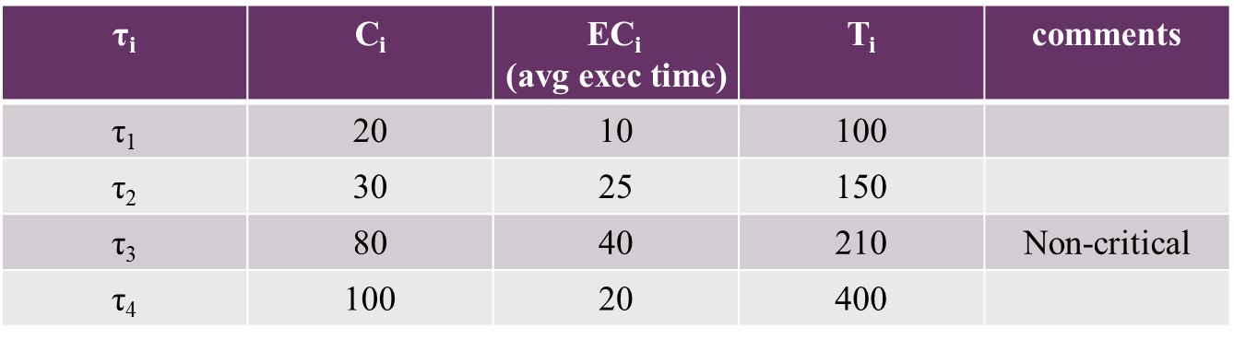
RM: Transient Overload
Solution 1: reduce Task₃’s priority by lengthening its period, possible only if Task₃'s relative deadline can be greater than its original period. In such a case, replace Task₃ by two tasks Task₃⁰ and Task₃⁰⁰, each with period 420, WC exec times C₃⁰ = C₃⁰⁰ = 80, avg exec times a₃⁰ =a₃⁰⁰ =40. Task₃⁰ and Task₃⁰⁰ must be phased to be 210 time units apart. If the set {Task₁, Task₂, Task₃⁰, Task₃⁰⁰, Task₄} is RM-schedulable, done.

Slide 67
RM: Transient overload
Solution 2: increase Task₄’s priority by splitting each invocation into two: Task₄⁰: C₄⁰ = C₄/2, a₄⁰ = a₄/2, T₄⁰ = T₄/2
{Task₁, Task₂, Task₄} or {Task₁, Task₂, Task₄⁰} are schedulable

Slide 68
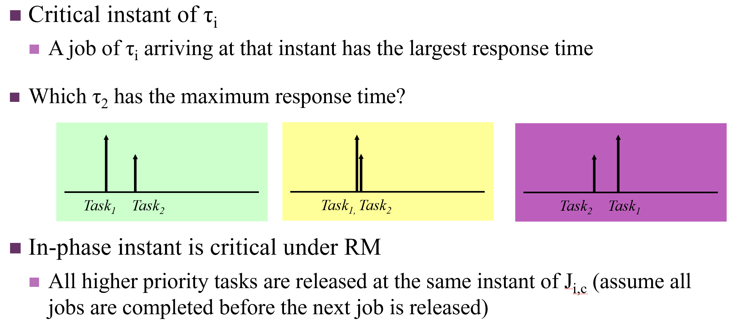
EDF: Schedulability Analysis
RM’s critical instants hold for EDF?
Why or why not?
τ₂
(10,4)
τ₄
(50,20)
τ₂
(10,4)
τ₄
(50,20)

Slide 69
EDF: Schedulability Analysis
EDF is schedulable iff U ≤ 1.0
U = 1/4 + 2/5 + 2/7
How to prove?
Using busy interval

Slide 70
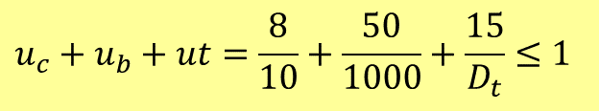
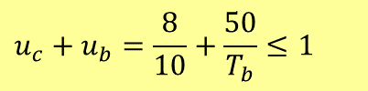
EDF: Schedulability Analysis
Example
A digital robot with EDF schedule
Control loop: C_{c}≤ 8ms at 100Hz
BIST (Built-in-Self-Testing): C_{b}≤ 50ms
BIST can be done every 250ms
Add a telemetry task to send and receive messages with C_{t}≤ 15ms
If BIST is done every 1000ms
The telemetry task can have a relative deadline of 100ms
Sending or receiving must be separated by at least 100ms
$$u_{c}+u_{b}=\frac{8}{10}+\frac{50}{T_{b}}≤1$$
$$u_{c}+u_{b}+ut=\frac{8}{10}+\frac{50}{1000}+\frac{15}{D_{t}}≤1$$

Slide 71
Summary: D_{i} = T_{i}
TFP: RM
U ≤ n(2^{1/n} – 1.0)
Response-time analysis (exact)
JFP: EDF
U ≤ 1 (exact)
JDP: LLF
U ≤ 1 (exact)
The three algorithms are optimal for each category.
All the results hold for sporadic tasks.

Slide 72
Extension: D_{i} = T_{i} → D_{i} ≤ T_{i}
TFP: DM (deadline monotonic)
∑ C_{i}/D_{i} ≤ n(2^{1/n} – 1.0)
Response-time analysis: a_{n} ≤ D_{i}, still exact
JFP: EDF
∑ C_{i}/D_{i} ≤ 1
Not exact, but there exists another exact analysis.
JDP: LLF
∑ C_{i}/D_{i} ≤ 1
The three algorithms are still optimal for each category.
All the results hold for sporadic tasks.

Slide 73
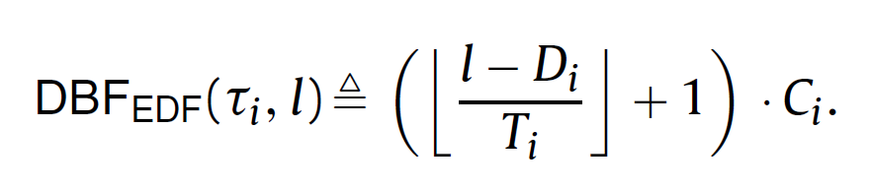
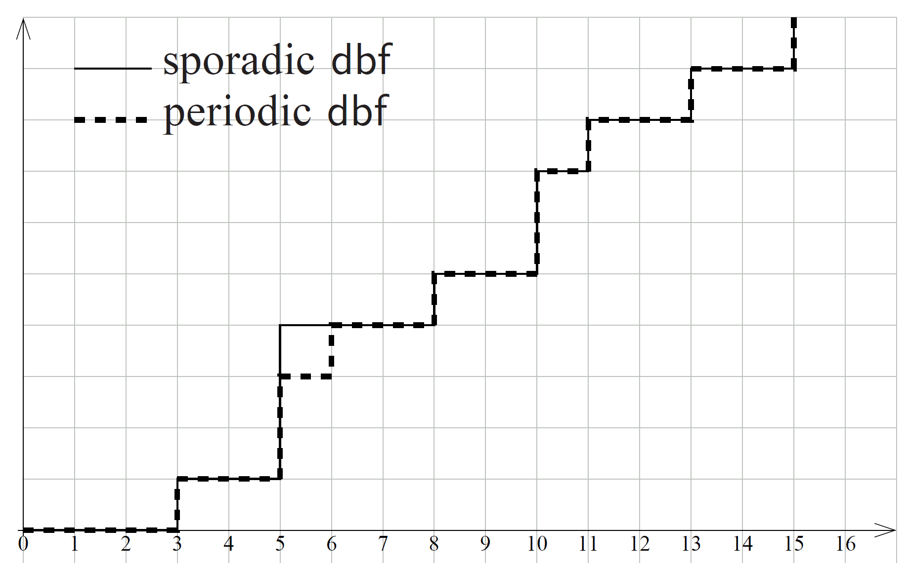
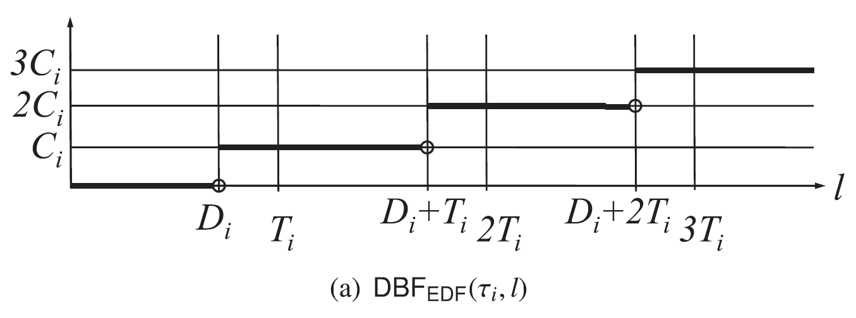
Extension: D_{i} = T_{i} → D_{i} ≤ T_{i}
JFP: EDF
Any exact analysis?

Slide 74
Extension: D_{i} = T_{i} → D_{i} ≤ T_{i}
JFP: EDF
Any exact analysis?
∑ DBF(Task_{i}, t) ≤ t, for all t>0
Proof
Busy interval

Slide 75
Where are we?
VxWorks, Xen, RT Linux
Practice
Theory
Preemption cost
analysis
D_{i} ≤ T_{i}
Dependent task model, e.g., resource sharing
A single processor
Hard deadline
Independent periodic tasks
d_{i} = p_{i}
Preemptable without any limit and overhead for context switch
Non-preemptive scheduling
Hierarchical model (virtualization)
Soft deadline

Slide 76
How to Apply This to a Target System?
Check
Task model
Any dependency?
Any shared resources?
(T, C, D) is given?
Platform
Constraints

Slide 77
SYNCHORNIZATION

Slide 78
CASE STUDY: BMS SYSTEM

